Slide 1
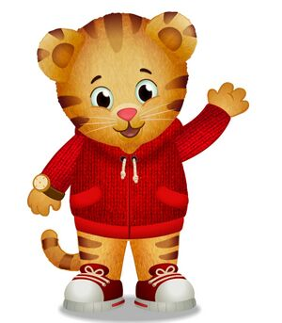
Ms. Haldaman
Pre-K 3
Meramec Elementary
Handbook 2022-2023

Slide 2

Overview
Absences
Birthdays/Celebrations
Classroom Expectations
Homework
Behavior Plan

Slide 3
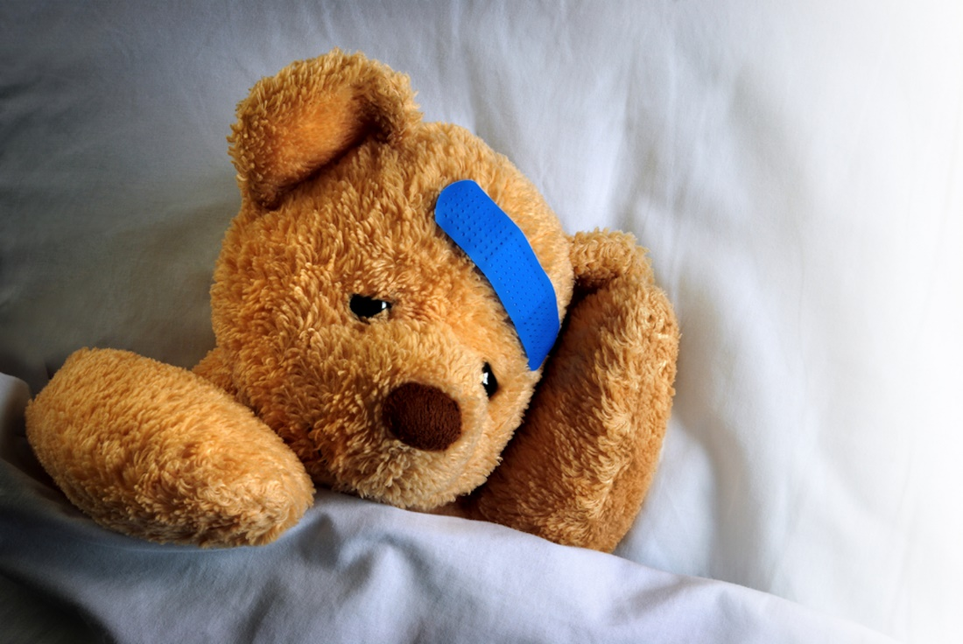
Absences
If your child is sick please keep them at home until they are well. Students must be fever free for 24 hours with NO medicine.
If your child is going to miss a day of school please notify the school at 314353-7145. You will also need to notify me through Class DOJO or email: Randi.Haldaman@slps.org.

Slide 4

Classroom Expectations
Safety is my number one concern. In order to keep the students safe please go over the following class expectations with your child.
Have eyes on the speaker
A quiet mouth
Raise their hand if they want to share
Have a calm body
Keep hands, feet, and object to themselves.

Slide 5

Birthdays and Celebrations
We will have holiday celebrations in the class.
If you would like to celebrate your child’s birthday please give me 3 days advance notice of when you would like to celebrate.
All treats must be store bought and sealed in order to be passed out.
Snacks must be store bought and sealed.

Slide 6

Homework
Communication is Key! Your child will have a daily folder that they will come home with Monday through Thursday. Inside that folder you will find notes and your child’s behavior log. Please initial the behavior log everyday.
Homework is important!!! It is a review of the things we have learned in the classroom. A home work packet will be given on Monday of each week. The packets will be due on Friday of the same week.

Slide 7

Questions and Concerns
If you have any questions or concerns please do not hesitate to contact me.
I can be reached through Class Dojo.
You may email me at Randi.Haldaman@slps.org
You may call the school at 314-353-7145
You may also speak to me at Drop off and Pick Up
I look forward to a great and exciting year with you and your child.

